Slide 1
3D reconstruction
Content creator: Aryan Mikaeili

Slide 2
3D data
We live in the 3D world
Images are compression of information in 2D
Much better if we could work directly on 3D data

Slide 3
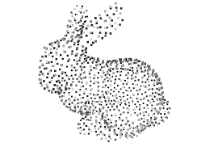
3D data (con’t)
Many faces of 3D data
Point clouds

Slide 4
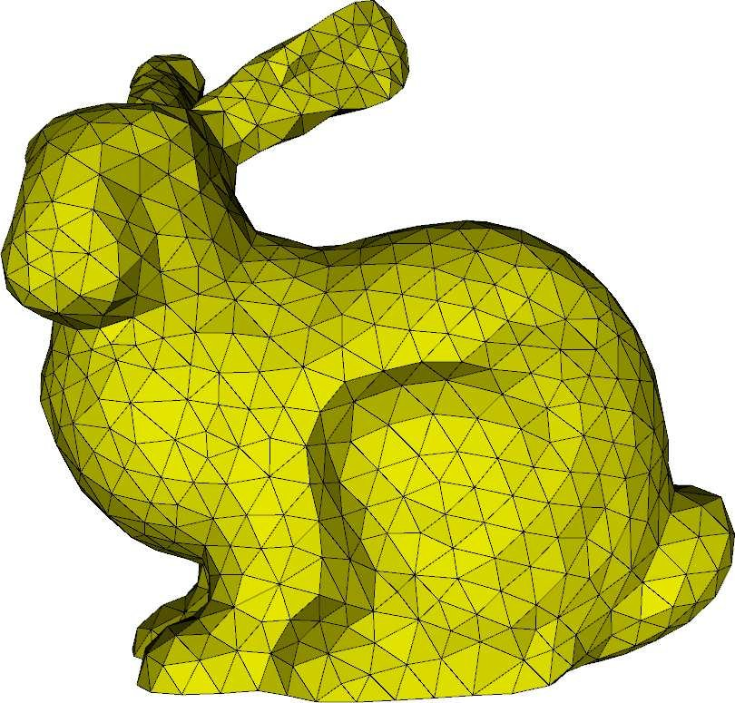
3D data (con’t)
Many faces of 3D data
Point clouds
Polygon meshes

Slide 5
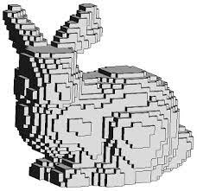
3D data (con’t)
Many faces of 3D data
Point clouds
Polygon meshes
Voxel grids

Slide 6
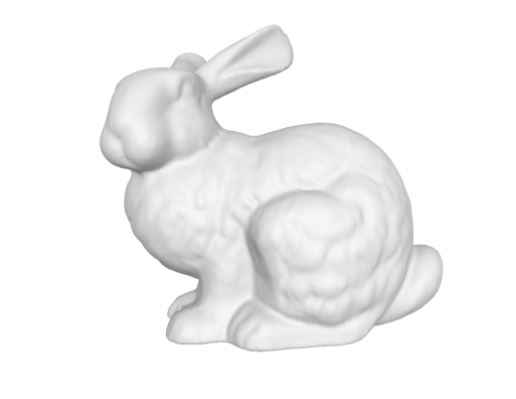
3D data (con’t)
Many faces of 3D data
Point clouds
Polygon meshes
Voxel grids
Multiview images

Slide 7
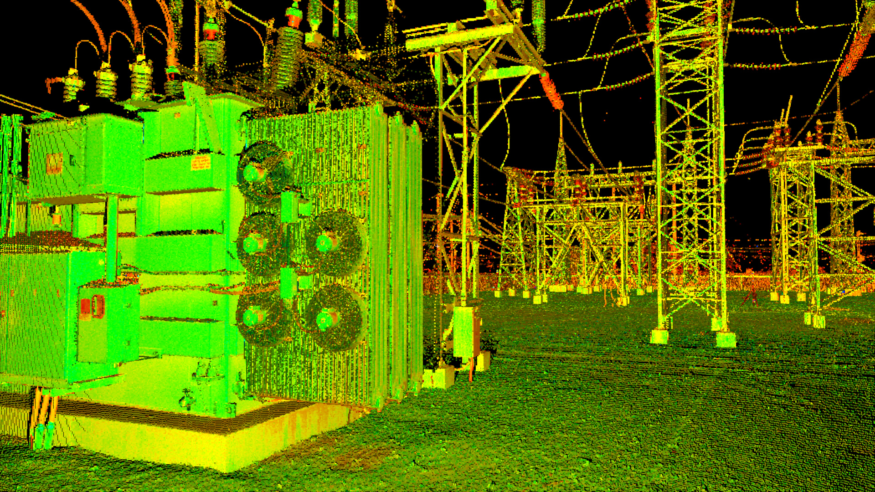
Point clouds
A set of unorganized points
Can Also contain other information like Color, Normals, etc
Simplest way of saving 3D data
Collectable using LiDAR scanners
Can be extracted with Multiview images

Slide 8
Point clouds
Easy to collect and store
Not visually useful
Usually we want to convert them to more complex forms of 3D data
Like Meshes

Slide 9
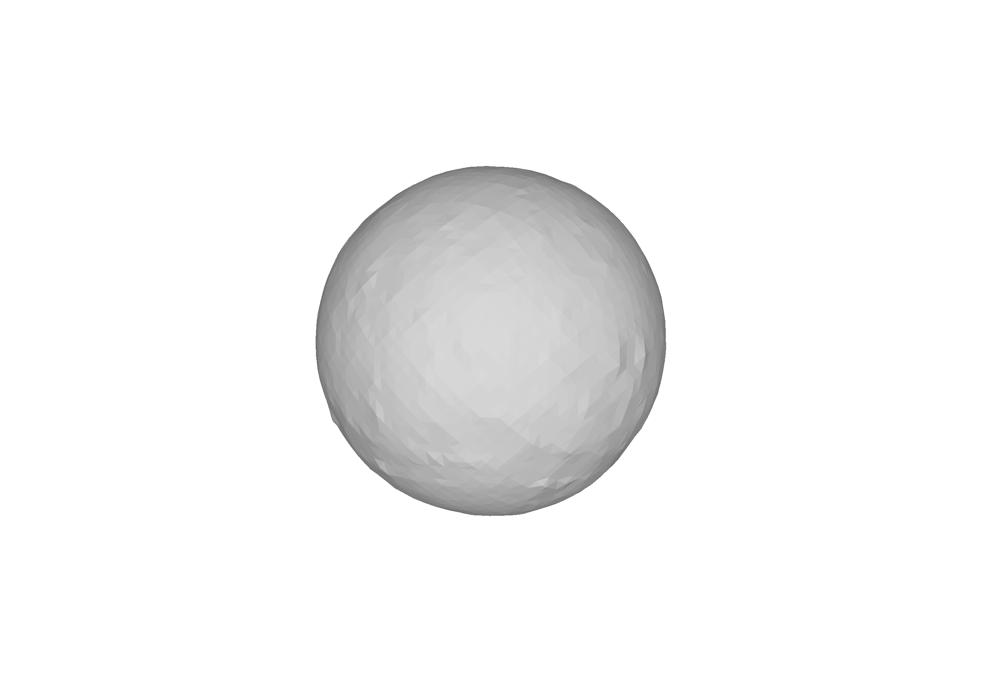
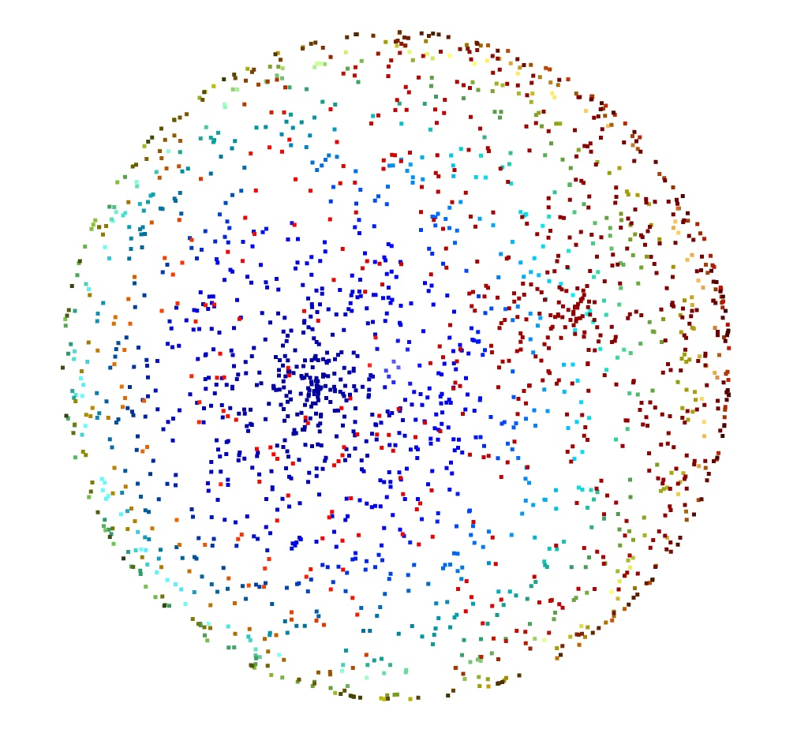
Task for today
Use what we have learned so far to convert a point cloud to a Mesh

Slide 10
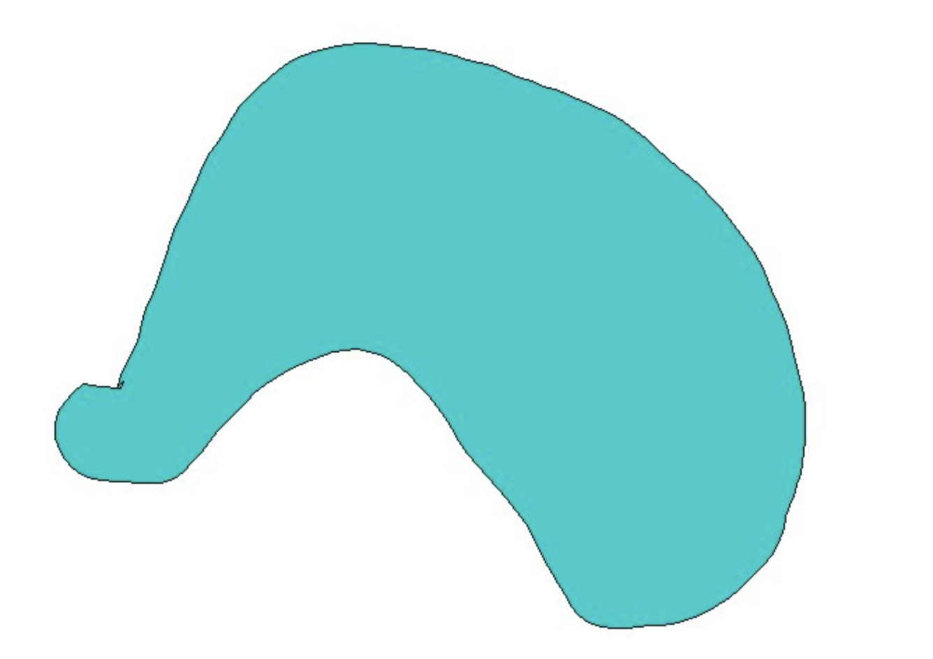
Occupancy and signed distance fields

Slide 11
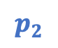
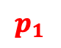
Occupancy and signed distance fields
$$p_{1}$$
$$p_{2}$$
$$p_{2}$$

Slide 12
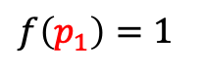
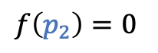
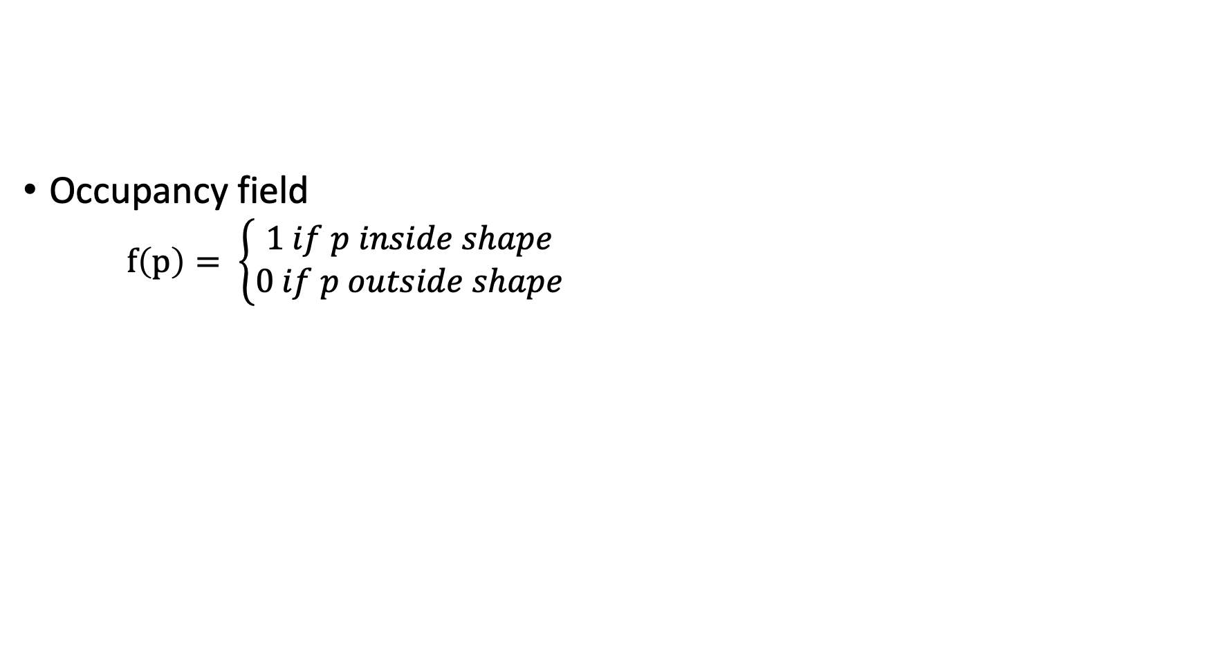
Occupancy and signed distance fields
Occupancy field
$f\left(p\right)= \left\{\begin{aligned}1 if p inside shape \\ 0 if p outside shape\end{aligned}\right.$
$f\left(p_{1}\right)=1$
$$p_{1}$$
$$p_{2}$$
$$p_{2}$$
$f\left(p_{2}\right)=0$

Slide 13
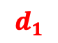
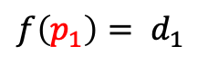
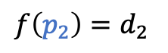
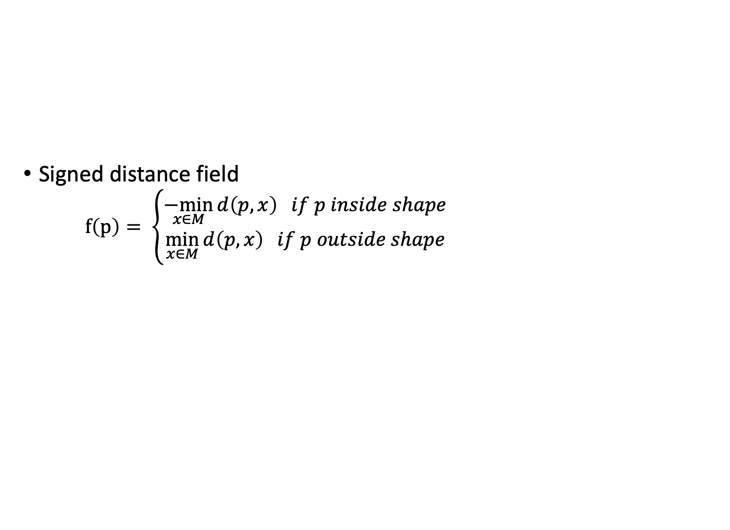
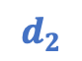
Occupancy and signed distance fields
Signed distance field
$f\left(p\right)= \left\{\begin{aligned}\underset{x∈M}{−min}{d\left(p, x\right) if p inside shape} \\ \min_{x∈M}{d\left(p, x\right) if p outside shape}\end{aligned}\right.$
$f\left(p_{1}\right)= d_{1}$
$$d_{1}$$
$$p_{1}$$
$$d_{2}$$
$$p_{2}$$
$$p_{2}$$
$f\left(p_{2}\right)=d_{2}$

Slide 14
Marching cubes algorithm
Let’s say that you don’t have the Mesh of a shape
You are only given the Occupancy function
You want to reconstruct the shape

Slide 15
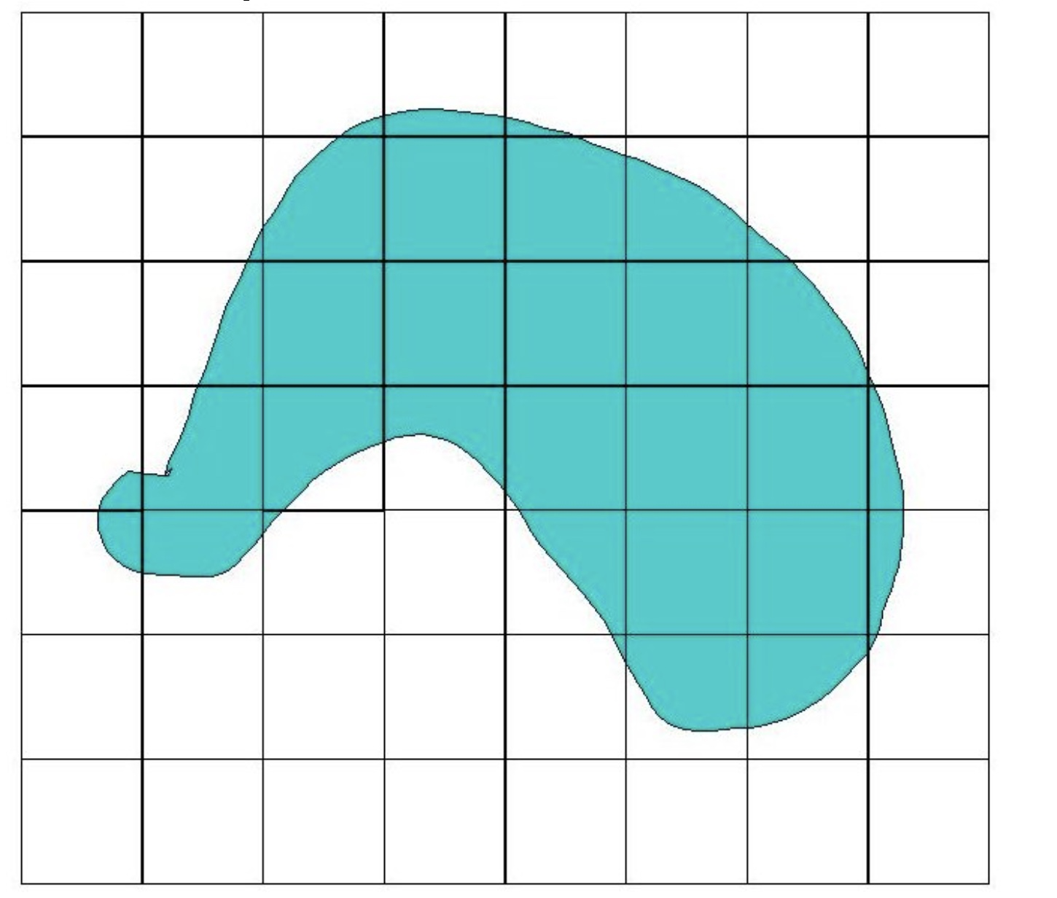
Marching cubes algorithm
In 2D (Marching squares)
Divide the space into squares

Slide 16
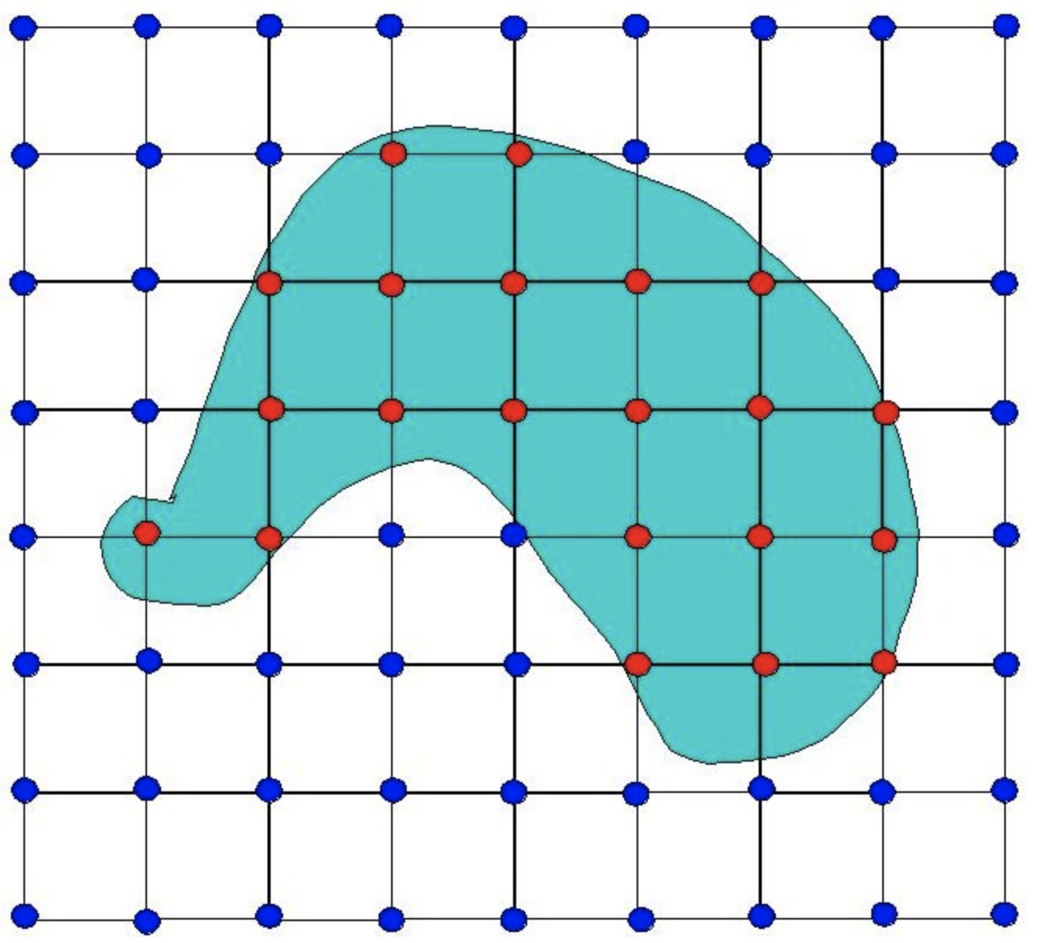
Marching cubes algorithm
In 2D (Marching squares)
Divide the space into squares
Query square vertices to the
occupancy function

Slide 17
Marching cubes algorithm
In 2D (Marching squares)
Divide the space into squares
Query square vertices to the
occupancy function
Design lookup table for all the states
that can happen
How many cases for 2D?
…

Slide 18
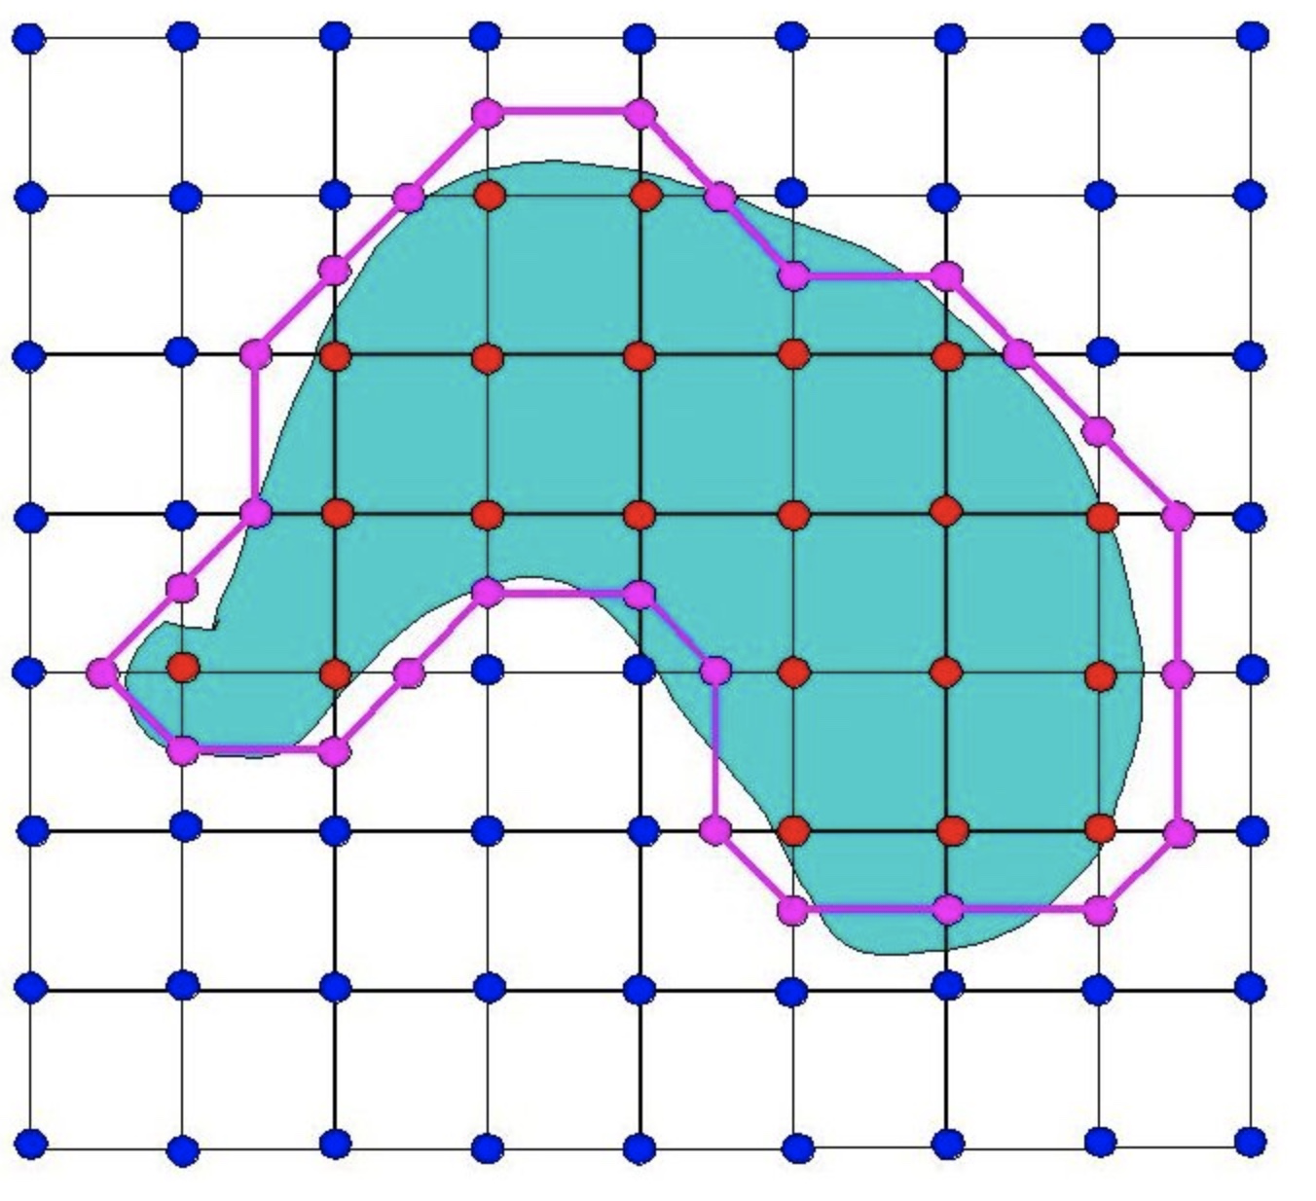
Marching cubes algorithm
In 2D (Marching squares)
Divide the space into squares
Query square vertices to the
occupancy function
Design lookup table for all the states
that can happen
How many cases for 2D?
Use lookup table to reconstruct shape

Slide 19
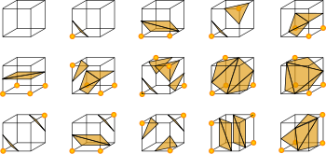
Marching cubes algorithm
In 3D
Similar to the 2D case
Lookup table should consist of 256 states
Exclude repetitions due to rotation
15 states in total

Slide 20
So far…
Occupancy fields/SDFs
Marching cubes
If we can extract SDF from a point cloud we are done

Slide 21
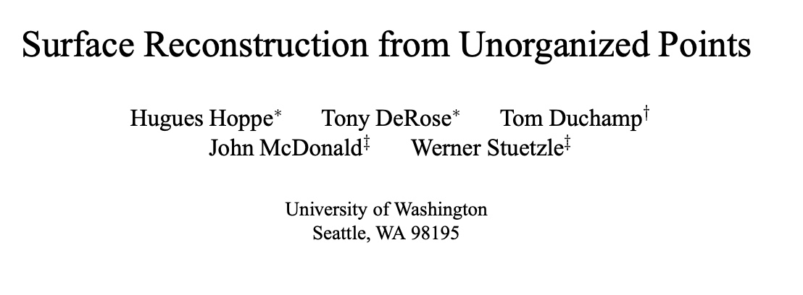
Surface reconstruction from unorganized points (Siggraph 1992)

Slide 22
Normal estimation from point clouds
For a point find its nearest neighbors

Slide 23
Normal estimation from point clouds
For a point find its nearest neighbors
What does PCA on these points give us?

Slide 24
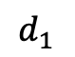
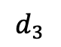
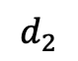
Normal estimation from point clouds
For a point find its nearest neighbors
What does PCA on these points give us?
$$d_{1}$$
$$d_{3}$$
$$d_{2}$$

Slide 25
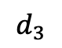
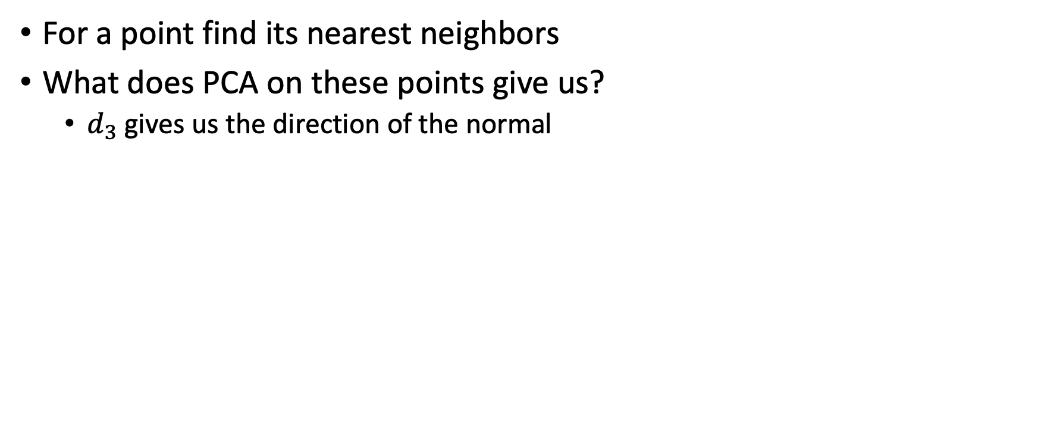
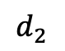
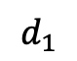
Normal estimation from point clouds
For a point find its nearest neighbors
What does PCA on these points give us?
$d_{3}$ gives us the direction of the normal
$$d_{1}$$
$$d_{3}$$
$$d_{2}$$

Slide 26
Tangent planes of the surface
For each point
Estimate Tangent plane of surface
Find KNN of the point
Find normal of the tangent plane
Mean of KNN points gives a point on the tangent plane
A plane can be defined by normal + one point

Slide 27
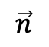
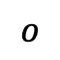
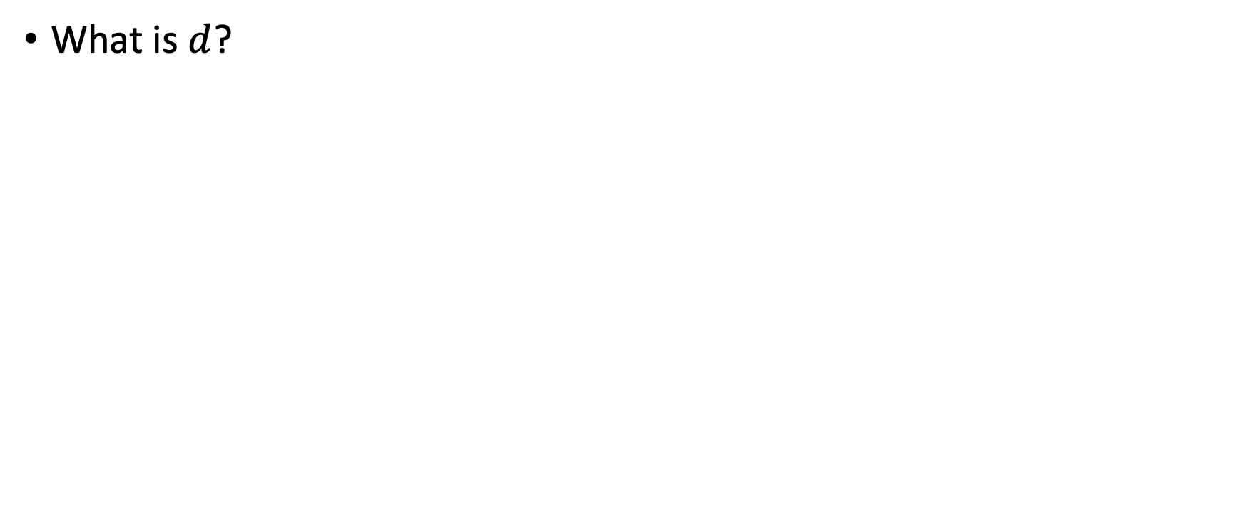
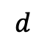

Define SDF on surface
$$p$$
What is $d$?
$$d$$
$$\vec{n}$$
Tangent plane
$$o$$

Slide 28
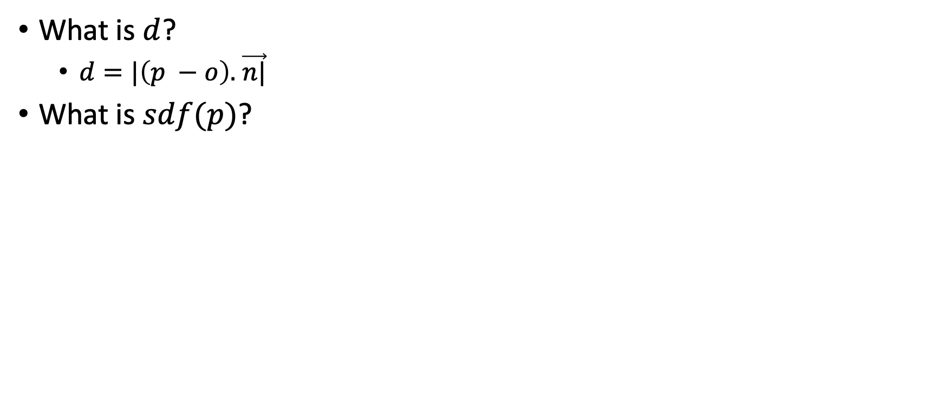
Define SDF on surface
$$p$$
What is $d$?
$d=|\left(p −o\right).$ $\vec{n|}$
What is $sdf(p)$?
$$d$$
$$\vec{n}$$
Tangent plane
$$o$$

Slide 29
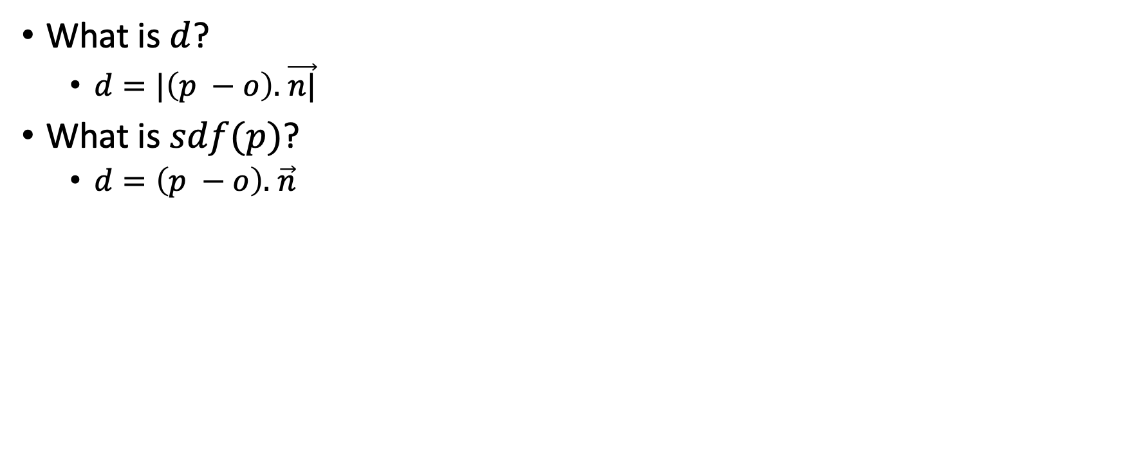
Define SDF on surface
$$p$$
What is $d$?
$d=|\left(p −o\right).$ $\vec{n|}$
What is $sdf(p)$?
$d=\left(p −o\right).$ $\vec{n}$
$$d$$
$$\vec{n}$$
Tangent plane
$$o$$

Slide 30
Steps to reconstruct surface from points
For each point
Find KNN
Find Tangent plane info
Normal
Point on Tangent plane
Define SDF
Find closest Tangent plane center to query point
Compute SDF using formula in slide 29
Run Marching cubes

